Slide 1
Group 8
Level 4/5 Group 8: Petrut Vasile, Sorin Cristea, Louis Vagner

Slide 2
Brief
LV
Choose a game genre
Change of a basic mechanic
Single player Game
Intuitive gameplay
Notes:
ASSESSMENT CRITERIA
Ability to deliver a complete game against an initial design specification.
Quality of game play experience.
Quality of iterative development of the game.
Ability to satisfy an identified market through appropriate game play design.
Ability to contribute to effective team working.
Ability to communicate game and individual progress in a consistent and effective manner to stakeholders.
Ability to produce assets in time and to standard.
Ability to use documentation and software related to project management in a consistent and effective manner.
Ability to reflect on work and to identify best practice on a range of issues.

Slide 3
Solution to the Brief
PV
RogueLike
No Perma-death
Solution : body switch with the killer
Notes:
A RogueLike game is characterized by a dungeon crawl through procedurally generated levels, turned-based gameplay, tile-based graphics and permanent death of the player character.
We took off the permanent death mechanic and decided instead that the player can never die. If your player loses against an enemy, you then take control of that enemy.

Slide 4
Mechanics
LV
Procedurally generated dungeon
Point and click movement & combat
Matching mechanic
Notes:
Target demographic

Slide 5
Dynamics
SC
Exploration
Combat
Looting

Slide 6
Aesthetics
SC
Easy fun
Sense of accomplishment
Wonder

Slide 7
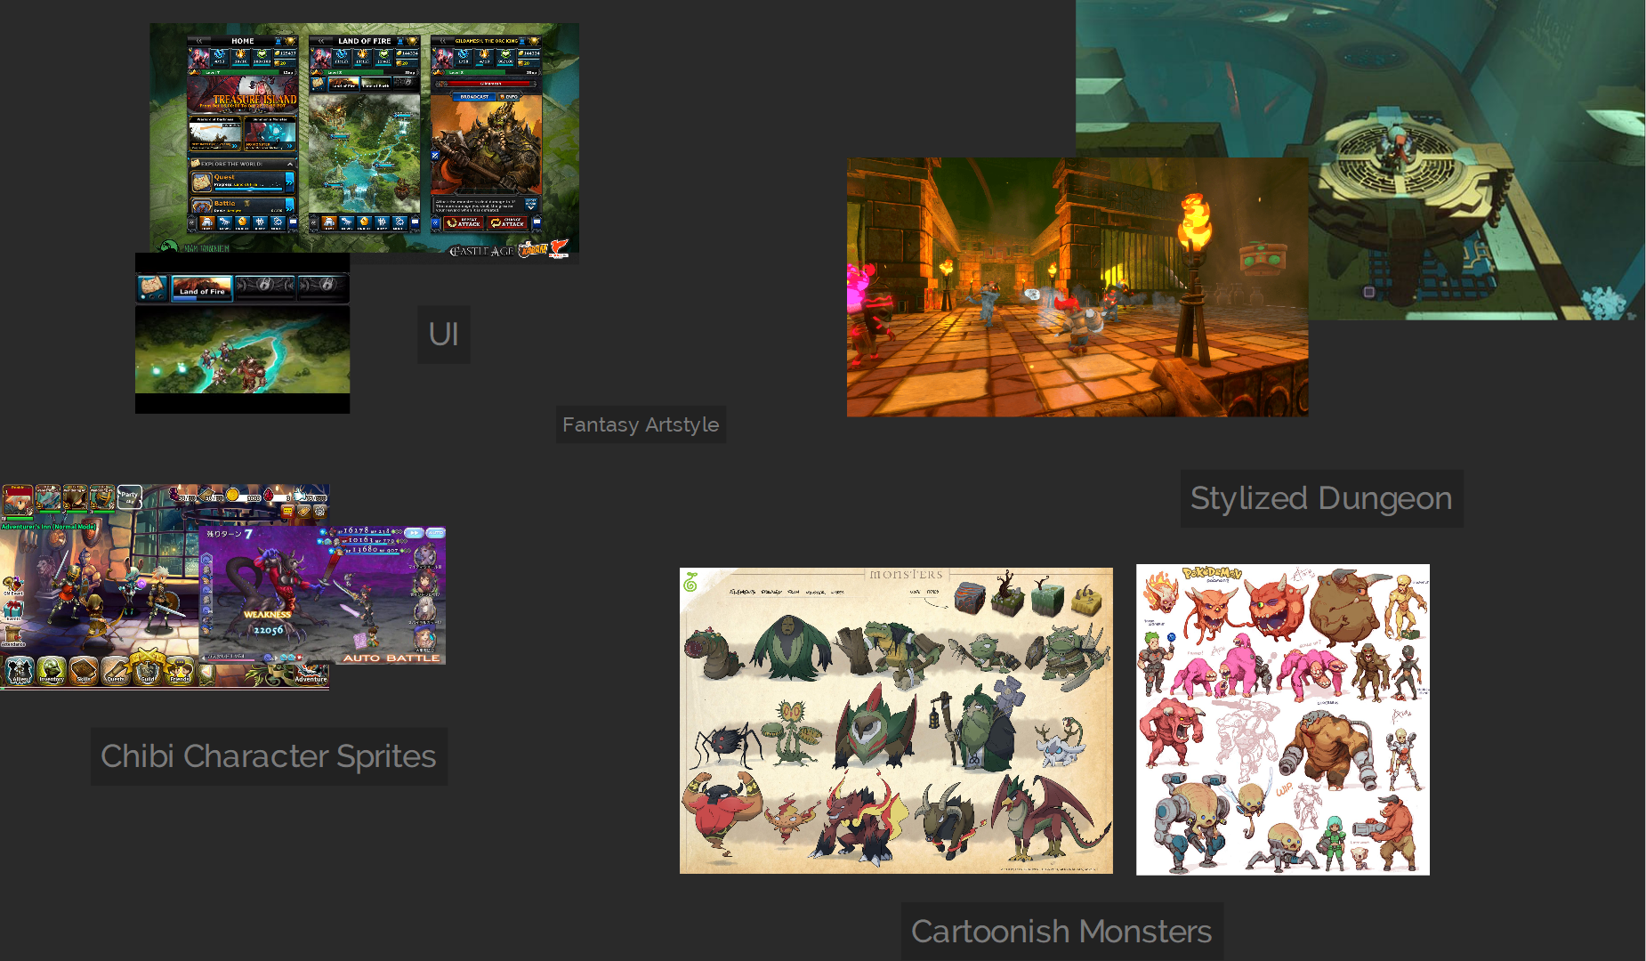
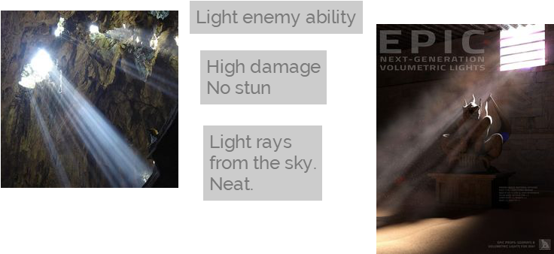
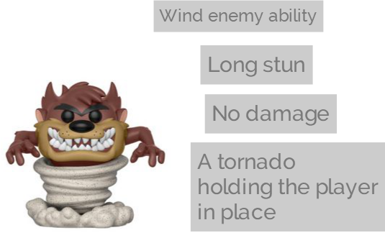
Moodboards
SC

Slide 8
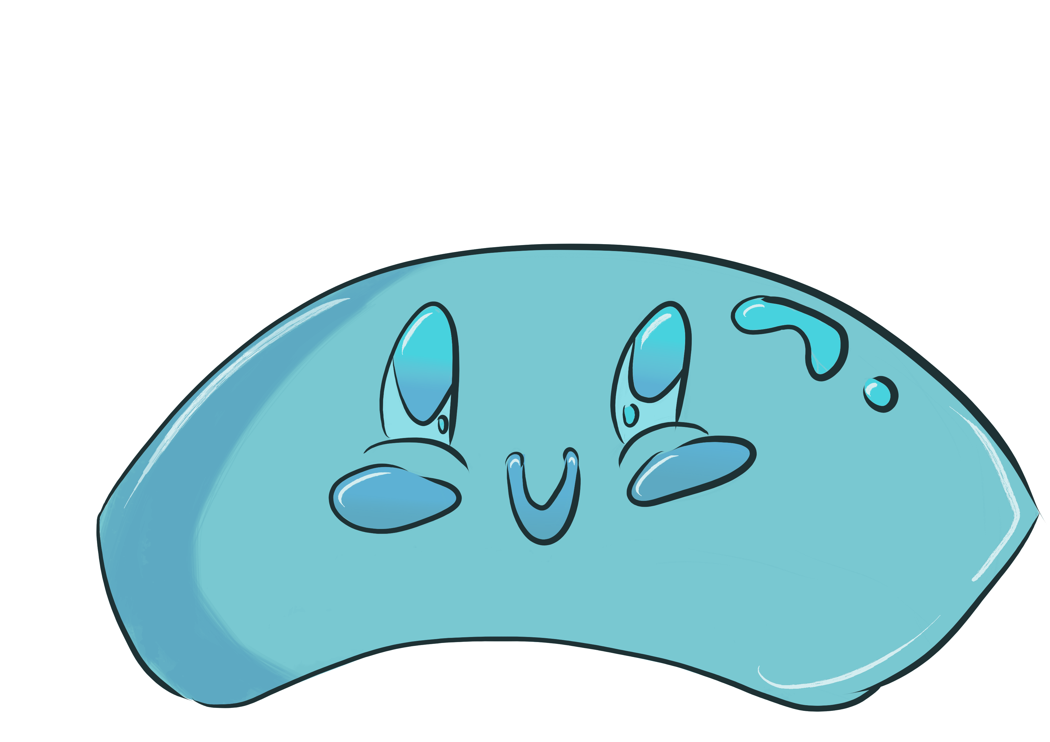


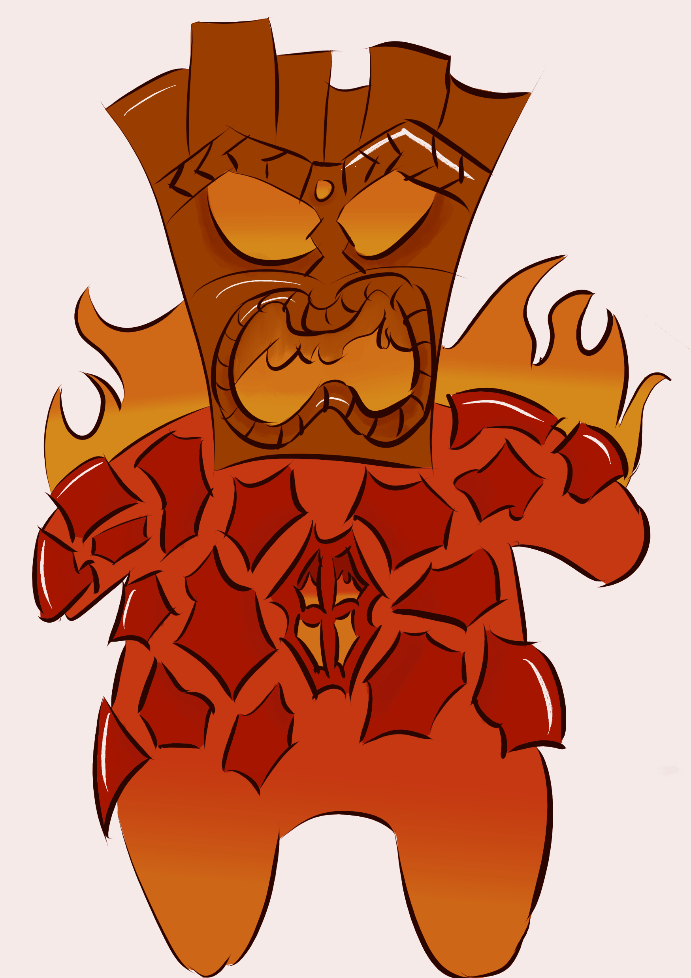

Art
SC

Slide 9
Walkthrough
PV

Slide 10
The following weeks
PV
Implementing narrative items
Creating a tutorial level
Testing
Balancing
Polishing

Slide 11
Questions?

